Slide 1



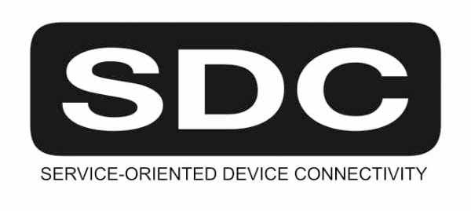





Safe Effective & Secure Medical Device Interoperability – Can we make sense of all these standards?!
Todd Cooper, AFC! “Standards Guy” ~ March 2020
FHIR is a trademark of Health Level 7, International.
SDC is a registered trademark of OR.NET

Slide 2
First: Some Definitions (standards guys love acronyms!)
SDO: Standards Development Organization … ISO / IEC / IEEE / IHE / HL7 / …
SES: Safe, Effective & Secure … simple reference to “JWG7” standards
Community focus: quality, regulatory & legal concerns [think “process guys”]
MDI: Medical Device Interoperability … “from the device interface” / MD2MD @ bedside
Community focus: research & engineering [think “tech guys”]
SDC: Service-oriented Device Connectivity … SOA for MD2MD interoperability @ bedside
SDPi: Service-oriented Device Point-of-care Interoperability … IHE “Profile” of SDC
FHIR: Fast Healthcare Interoperability Resources … HL7 standard taking world by storm!

Slide 3
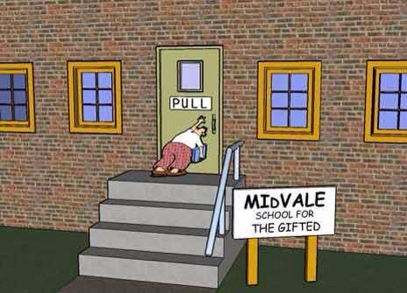
Does it have to be this hard?

Slide 4
The Problem of SDO & Standards Multiplicity
Problem #1: All these SDOs … all these standards = Confusing Complexity
Impact: Need a “Standards PhD” to sort out what is relevant from what is noise
Problem #2: SES & MDI Communities … don’t work well together!
Impact: Their standards are also developed in decoupled parallel universes
Problem #3: Requirements inconsistently specified, not “CA Ready”, not integratable
₩
₩
₩
Impact: Companies have to spend huge … inefficiency & status quo rut
Problem #4: Real-world products have to achieve this integration in an ad hoc manner
Impact: Companies have to form “requirements management” teams and tools …

Slide 5
Ultimate Problem …
Companies have finite time and resources for product development!
Ultimate Impact …
Use standards? Forget it!
After 40 years of effort, SES MDI doesn’t exist!

Slide 6
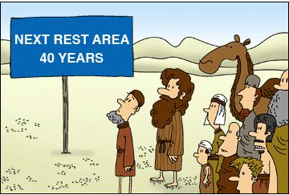
Is there hope?!
As we ponder the NEXT 40 …

Slide 7

What do standards guys do to “make sense of it all”?
Write more standards … of course!
+ Build frameworks …

Slide 8
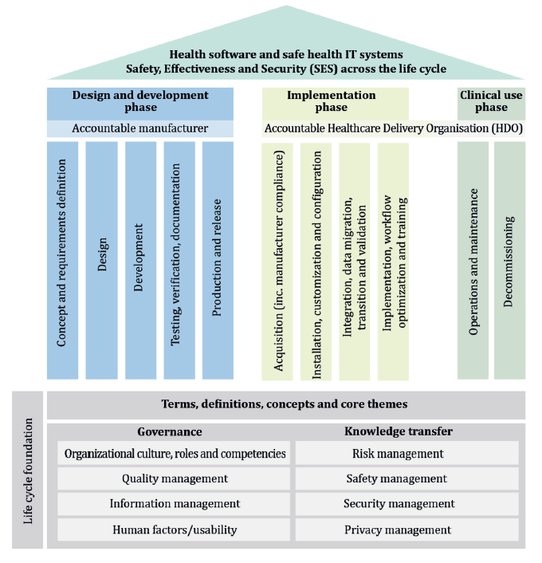
JWG7 “SES Guys” standardized their own framework
The JWG7 SES “Temple Diagram” identifies core topic / subject areas …
… standardized in 81001-1 …
82304-1
80001-1
… over which you can “make sense of” specific standards …
… all with a process / quality / regulatory / legal “SES” community subject focus
81001-1

Slide 9

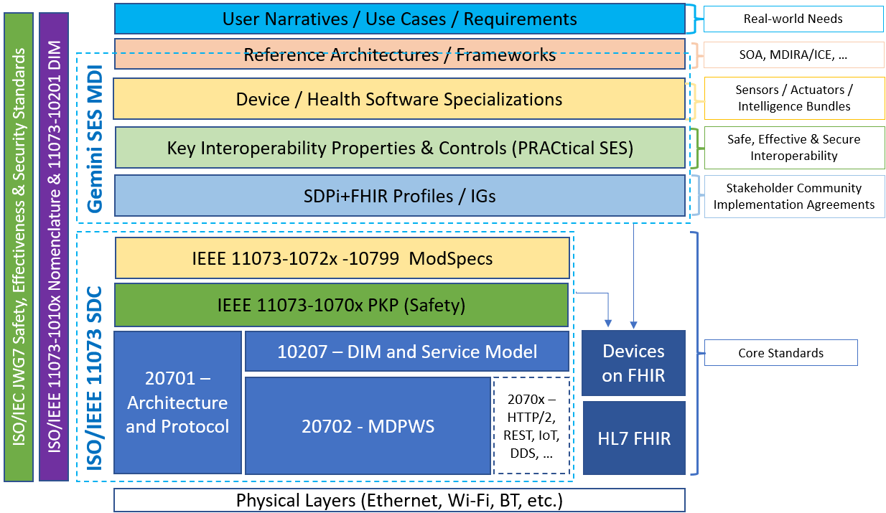
What about the “MDI Guys”?
Consider the SES MDI “Hanging Gardens” Framework …
SES MDI Plug-n-Trust Interface
(More @ https://confluence.hl7.org/x/4ijxB)

Slide 10
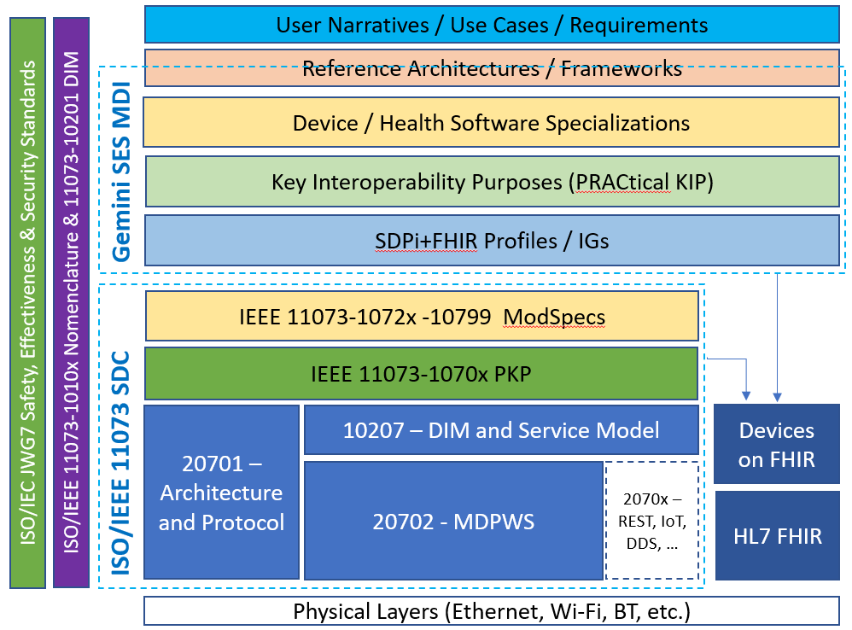
But does this truly help or just add to the confusion?!
“Beauty is in the eyes of the beholder” … in this case, Standards guys!
… the Gardens help “make sense” of specific standards from different SDOs … in a pragmatic real-world product context …
… all with a combined technical & process “SES MDI” community subject focus
SES MDI Plug-n-Trust Interface
(More @ https://confluence.hl7.org/x/4ijxB)

Slide 11
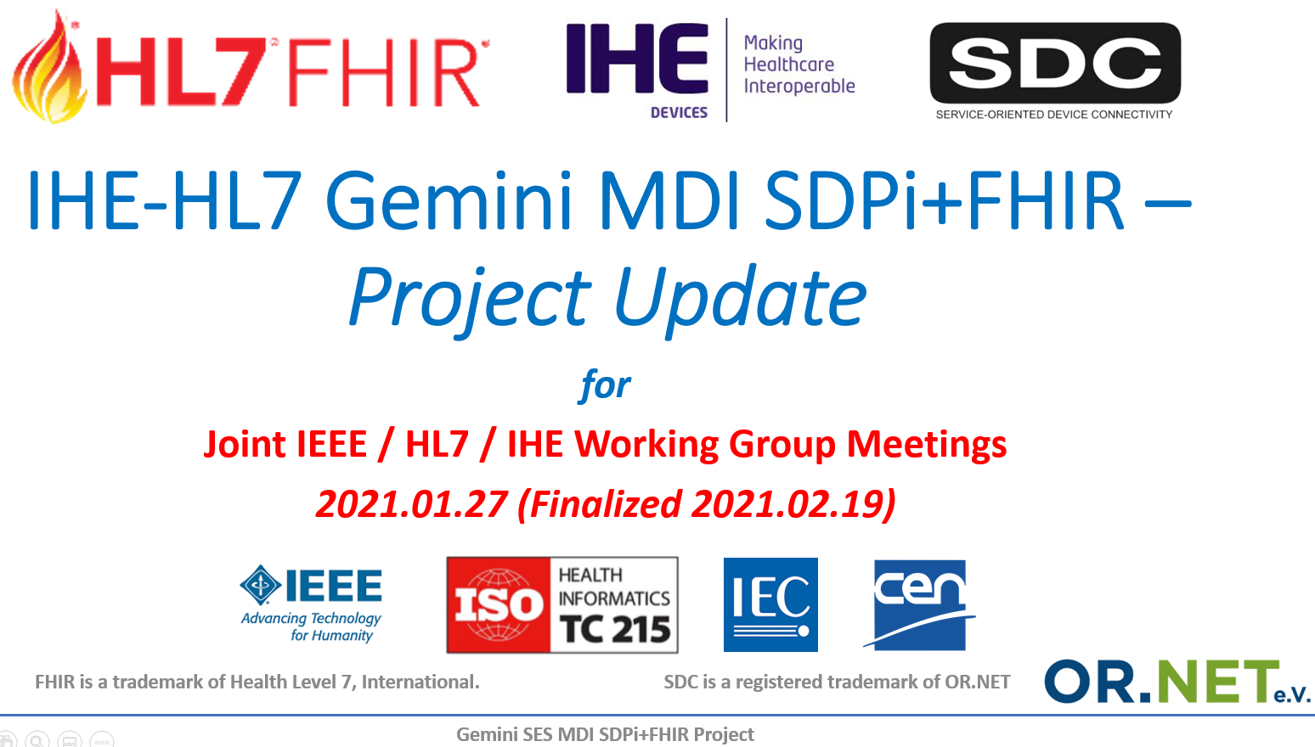
Yes! There is hope … the Gemini SES MDI Project!
Year 3 Update @ https://confluence.hl7.org/x/Xzf9Aw

Slide 12

Innovators Challenge: One Interface / <X> Standards
The Hanging Gardens framework provide a perspective on the various standards and specifications that are integrated into each individual product’s interface …
One Layer &
One Standard
at a Time!
SES MDI Plug-n-Trust Interface

Slide 13



Innovators Hope: Requirements Integration
The Hanging Gardens framework can also enable a much simpler, streamlined requirements pathway through through each standard’s needs & capabilities …
… the Happy Path charts traceability from the interface back to each standard specification and their requirements
How hard can it be?!
SES MDI Plug-n-Trust Interface

Slide 14
Life Without RI – In a Hanging Gardens World
In the absence of a clearly defined Requirements Interoperability model to enable connection between standards …
How hard can it be?
PRETTY HARD!!!
(via Ad Hoc Requirements Integration)
SES MDI Plug-n-Trust Interface
14

Slide 15
Standards Guys’ Challenge @ SES MDI RI
Gemini SES MDI Project Focus (2021/Year 3):
Challenge #1: Standards are inconsistent in how they specify requirements
Focus Area: Establish a Requirements Interoperability Model & Inter-Standard Mappings (Capabilities “API” + Needs / Dependencies)
Challenge #2: Crafting standards specifications that support RI & “Happy Path” Tracing
Focus Area: Create authoring tools that transparently capture the computable artifacts necessary for standards integration automation
Challenge #3: Conformity Assessment reports that are “Regulatory Submission Ready”!
Focus Area: Generate test plans & test scripts that ensure verification of requirements + traceability & CA to <X> standards & specifications
Challenge #4: HTML-based “continuous build” publication supporting implementation
Focus Area: Develop publication tooling that enables frequent (daily) updates & inter-standard integration / navigation

Slide 16


Next Step: Requirements Interoperability Pilot
Gemini SES MDI RI Pilot Standards could include:
Use Cases: Silent Bed & Isolation Point-of-Care
“MD-SOA” & MDIRA/ICE Architectures
ISO/IEC 60601-1-8 & -2-x Safety & Essential Performance stds.
IEC 80001-1 2nd Edition
IHE SDPi+FHIR Profile & MDIRA Profiles
IEEE 11073-10700 Participant Key Purposes standard
IEEE 11073 SDC Core Standards
RI Pilot tasks include:
Crafting an interoperability semantics UML Metamodel (including OMG ReqIF)
For each standard, drafting representative set of requirements using metamodel
Creating inter-standard requirements mapping “links”
Validate ability to trace “Happy Path” from interface to implemented standards

Slide 17
Next Step … for YOU!
Many opportunities to participate & learn & shape the future of SES MDI:
Medical Device Industry Promotion Foundation @ www.medif.or.kr
Smart Medical Device Standard Expert Forum @ project.medif.or.kr/subList/10000003198
Gemini SES MDI Project @ confluence.hl7.org/display/GP/Community+Engagement

